Slide 1

Product Cooks
Group Project 1: Agile Product Development Group Project

Slide 2
Introductions
Group 1 - The Product Cooks
Sophie Worrell
Matt Schirber
Gbolahan Oladayo
Zara Rahman
Notes:
Intro of Team Members
Name of Product and Team

Slide 3
Agenda
Product Discovery
Demo
Backlog, Sprint, and Roadmap Overview
Process
Q&A

Slide 4

Problem?
No tools or resources to help parents teach their teens financial literacy

Slide 5



Ezy Swipe Teen Credit Card
from Access Plus
Parent
Teen

Slide 6
Ezy Swipe Features and Benefits
Features:
Low interest rate on credit card
No fee on credit card
Cashback Incentives
Benefits: (addresses our 3 MVP)
Aids in strong collaboration between parents and teens
Encourages financial e-learning
Educates teens on how to manage spending and budgeting with parent supervision

Slide 7
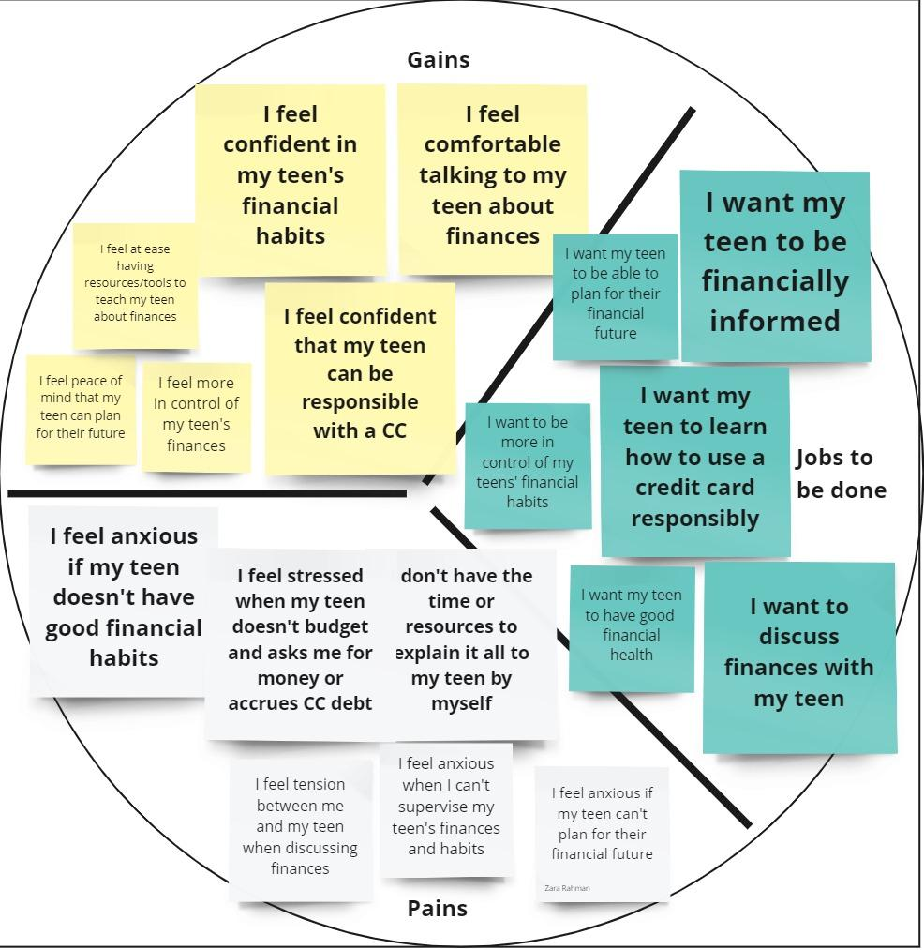
Value Proposition Canvas - Customer Canvas
Miro link: https://miro.com/app/board/uXjVPSzSgiM=/?share_link_id=280774316895

Slide 8
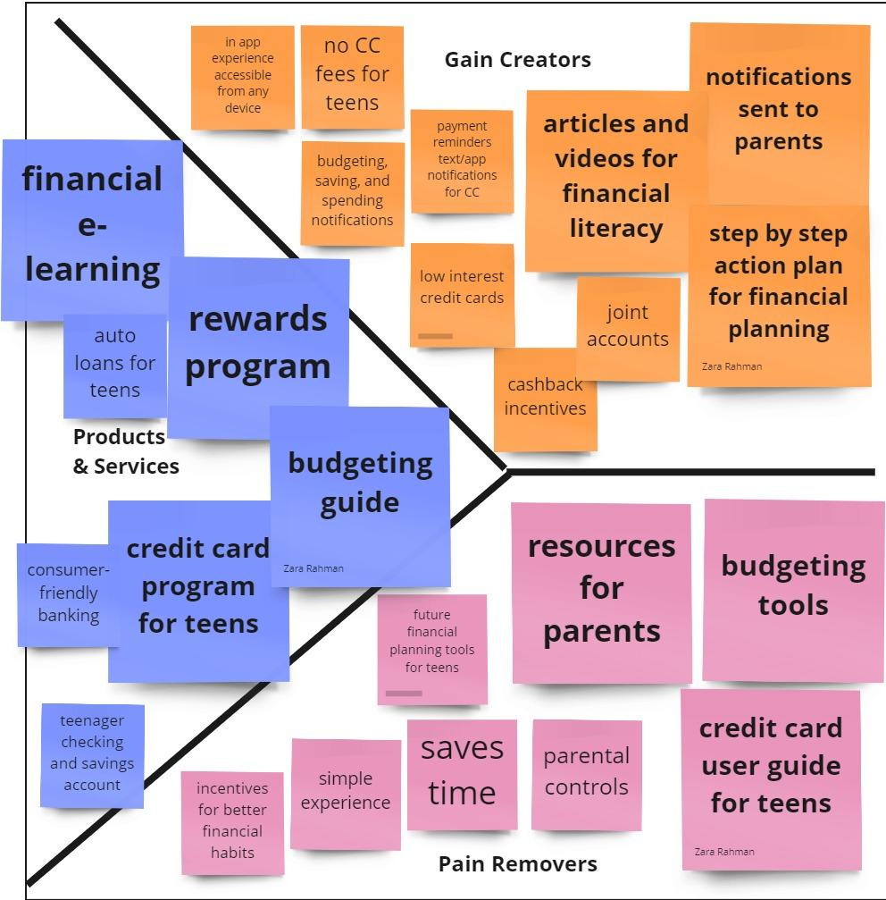
Value Proposition Canvas - Product Canvas
Miro link: https://miro.com/app/board/uXjVPSzSgiM=/?share_link_id=280774316895

Slide 9
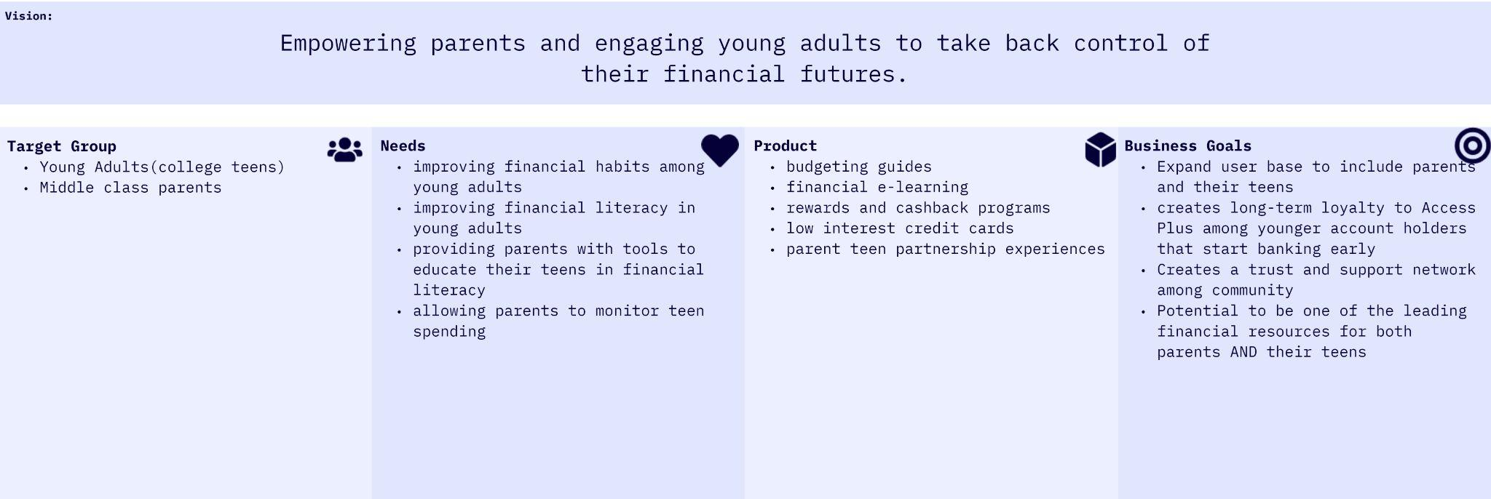
Product Vision Board - Ezy Swipe Credit Card
Miro link: https://miro.com/app/board/uXjVPSwteDU=/?share_link_id=972091224428

Slide 10
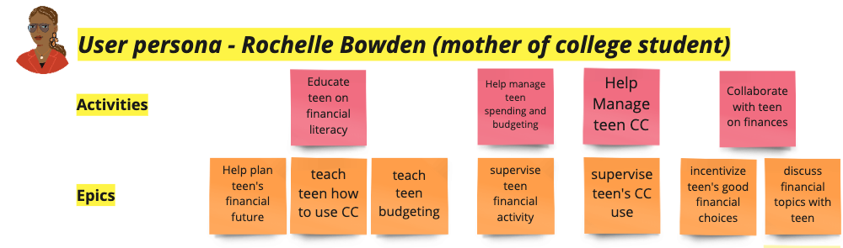
User-Story Map
Miro link: https://miro.com/app/board/uXjVPSJYnk4=/?share_link_id=129882822634

Slide 11
Interactive Prototype Findings
Demo
MVP solves problem by prioritizing features
Joint collab topics
Daily tips for communicating with teen on finances
Credit card learning modules to be completed BEFORE teen can use credit card
Effectiveness of parent teen collaboration still unknown
Basic joint account view descoped since emphasis is on collaboration first
Invision link: https://zararahman16608.invisionapp.com/console/share/DKBVGE879CA/960019940

Slide 12
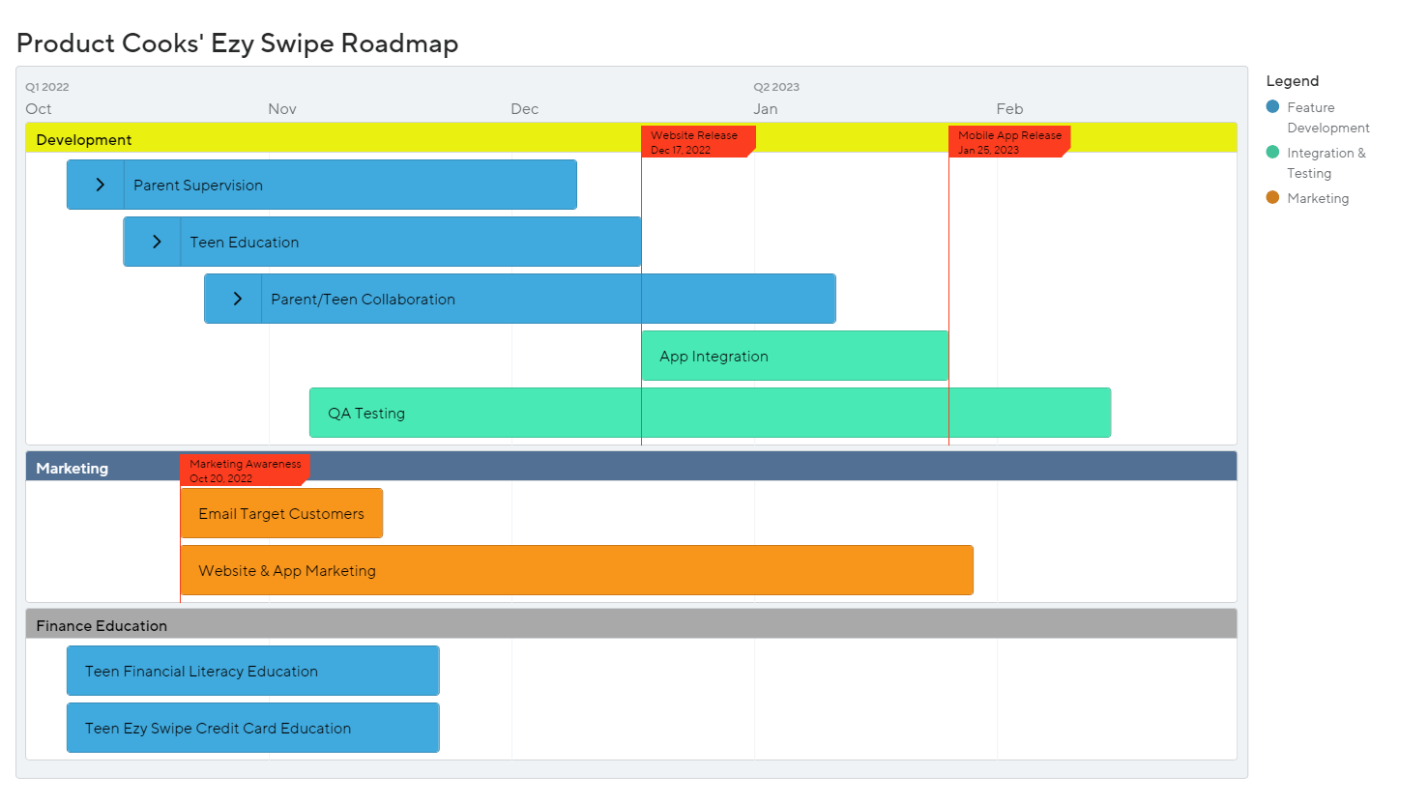

Slide 13
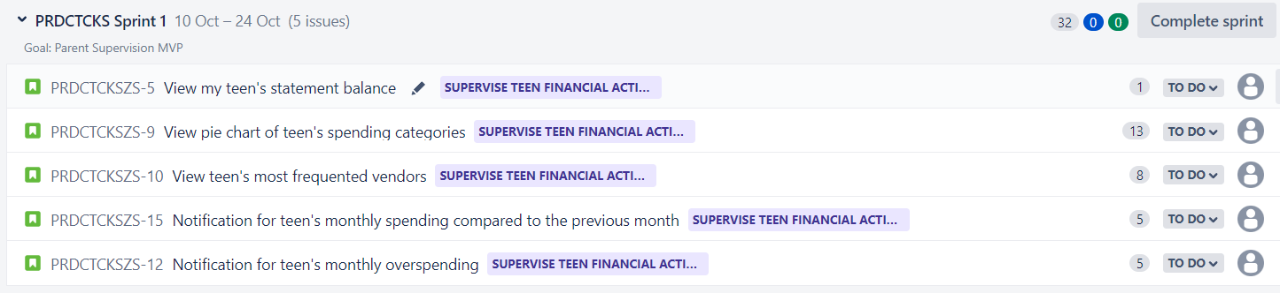
Sprint 1

Slide 14
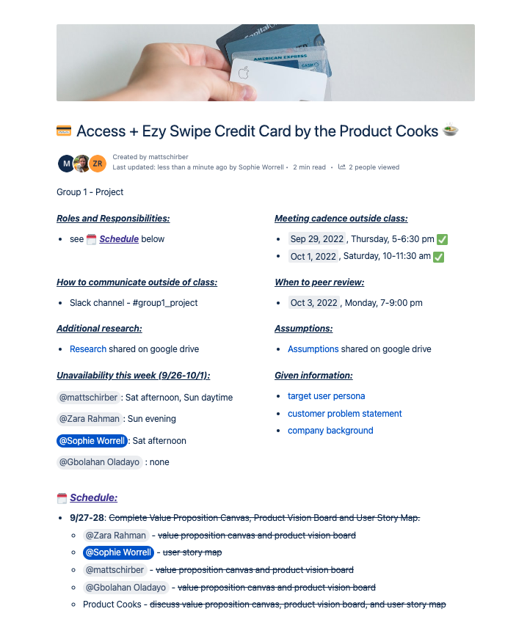
Process
Confluence page
Schedule
Meetings
Delegation
Group Effort
Notes:
Group effort - our meetings, this page
Everyone played to their strengths to divide and conquer
Used confluence for updates and organization, and delegation
Challenge- whether to target parent or teen

Slide 15
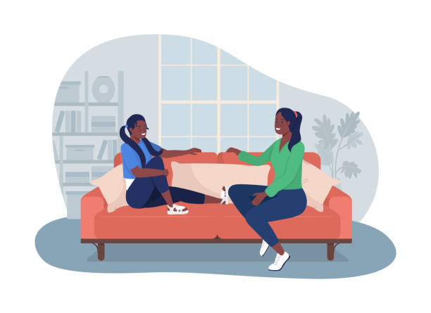
Challenges Encountered
Product Perspective
Parent vs Teen perspective

Slide 16
Questions?

